Slide 1
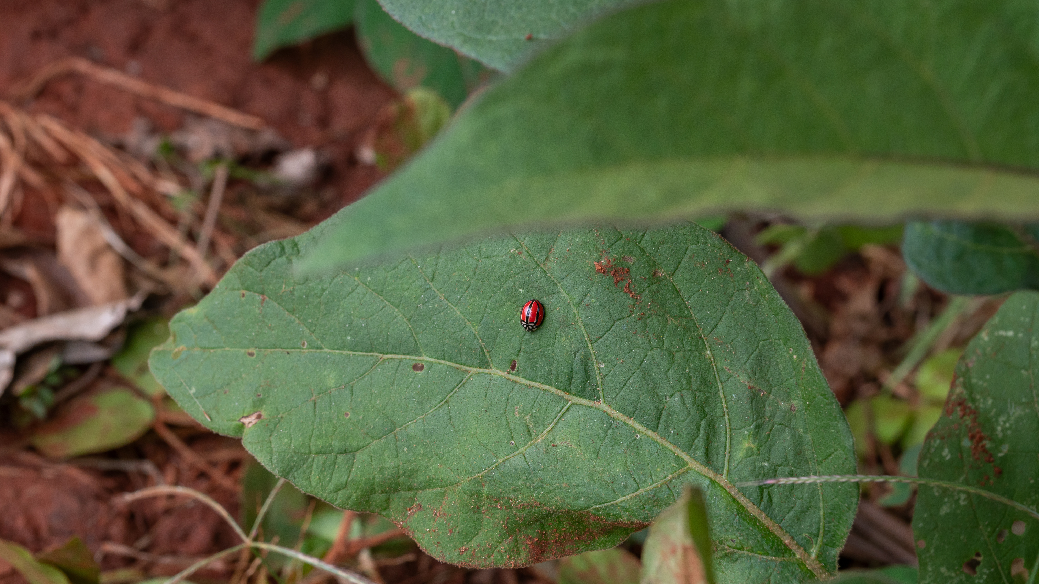
Stories & Strategy
Fundraising through Relationships and Narrative
Developed by Rachael Kirui, Communications Strategist & Impact Storyteller

Slide 2
Brief Introduction
Hi, my name is Rachael
I’m an Impact Storyteller & Strategic Communications specialist working at the intersection of agroecology, systems change, and social entrepreneurship.

Slide 3
Objectives
DEMYSTIFY
EQUIP
FOSTER
fundraising communications by introducing simple, effective strategies that even resource-constrained teams can implement.
participants with practical tools to craft compelling stories that combine emotion and evidence to attract and sustain funder interest.
a mindset shift from scarcity to strategy; encouraging organizations to see communication as a relationship-building tool, not just a one-time output.

Slide 4
What are some real struggles you’ve faced when trying to communicate your work to funders?
https://www.menti.com/alrxzs8bbbqq

Slide 5
Key challenges
WEARING MANY HATS, LIMITED TIME
“We’re doing everything! from fieldwork to reporting to comms, and fundraising messaging often falls through the cracks.”
LACK OF CLEAR, READY-TO-USE MATERIALS
NOT KNOWING WHAT FUNDERS NEED TO HEAR
“We don’t have a one-pager, impact deck, or a consistent ‘About Us’ we can send when opportunities come.”
“How do we balance data and storytelling? What’s too much or too little to share?”
FEAR OF REJECTION OR DONOR FATIGUE
DIFFICULTY SHOWING IMPACT CLEARLY
FEELING PRESSURE TO SOUND 'PERFECT' OR FORMAL
“We know we’re making a difference, but we struggle to explain that in a way funders understand.”
We’ve tried before, but didn’t hear back — so we don’t know if it’s worth the effort.
“We think we need to sound academic or polished, and that blocks our real story from coming through.”

Slide 6
This session is about giving you lightweight tools to move past these blocks, even with limited time and resources.

Slide 7
Fundraising Comms Strategy
Developed by Rachael Kirui

Slide 8
A fundraising communications strategy is a simple plan to share your impact story with the right funders or supporters — in the right way, at the right time — so they are moved to give, invest, or partner with you.
Even small teams can benefit from a fundraising communications strategy because it saves time, builds trust, and helps you speak clearly and confidently to the right funders.

Slide 9
Focus 1: Audience
Different funders want different things
DONORS
GRANT FUNDERS
People who give money because they believe in your mission. They want emotional stories and clear impact.
Organizations that provide grants often want clear goals, data, and evidence of success.
IMPACT INVESTORS
Your content and story should be tailored depending on who you’re trying to attract.
Interested in market-based solutions and how you generate financial and social returns.

Slide 10
Focus 2: Content Alignment
Different funders want different things, in different formats, for different platforms
4. Where do they spend time? (Social media, email, events, reports)
Who am I trying to reach? (Donors, foundations, investors, community partners)
5. How can I best reach them? (Short videos, newsletters, personal meetings, formal proposals)
2. What motivates them? (Impact stories, numbers, innovation, sustainability)
3. What information do they need to trust and support me? (Proof of impact, financial sustainability, values alignment)

Slide 11
Impact storytelling
Combine data + emotion
Developed by Rachael Kirui

Slide 12
EMOTION- SPARKS CONNECTION
3 Core Elements
DATA -BUILDS CREDIBILITY
HUMAN FACE -MAKES IT MEMORABLE

Slide 13
GROUNDED IN REAL PEOPLE & PLACE
Start with a farmer, youth, or community in a real agroecological setting. Give a name, a location. Set the soil.
RESULT-DRIVEN, BUT SIMPLE
Add one clear result — number, change, stat. No jargon. Think “X families now grow 3 crops instead of 1.”
ORGANIC FLOW OF CHANGE
G.R.O.W Method
What changed over time? From problem → action → visible shift (soil, market, mindset, income, dignity).
WOVEN WITH FEELING
Emotion is what sticks. Include a quote, an image, or a reaction. “Now my children eat every day.” “The land is alive again.”

Slide 14
Open Critique
Our integrated pest management program reduced crop losses by 42% across 6 counties. Adoption rate of the practices was 57.3%, with a 22% increase in yields.

Slide 15
Good example
In Busia, John used to lose nearly half his maize to pests. ‘I was tired of watching my effort disappear,’ he says. After learning to use organic sprays and crop rotation, he harvested 8 full bags ; double last season. ‘Now my children eat every day, and I even sold two bags.

Slide 16
Open Critique
We enhanced soil organic matter by 13.6% through application of compost at a 3:1 ratio, increasing microbial biomass and reducing synthetic inputs by 18kg/ha.

Slide 17
Good example
Teresa used to say her soil was like sand. Nothing held water. But after learning how to compost with farm waste, her land holds moisture, and her kale is thick and green. ‘My soil is alive again,’ she says. She’s even helped 4 other women start composting.

Slide 18
Open Critique
Through a systems-based approach, we impacted over 12,000 individuals through scalable agroecological pathways and inclusive capacity building.

Slide 19
Good example
12,000 people, yes. But start with Beatrice in Kitui. Her goats kept dying during dry seasons. She joined our fodder-growing group and now harvests Napier grass. This year, not one goat died. ‘I feel safe,’ she says. Multiply her by 12,000 , and that’s our story.

Slide 20
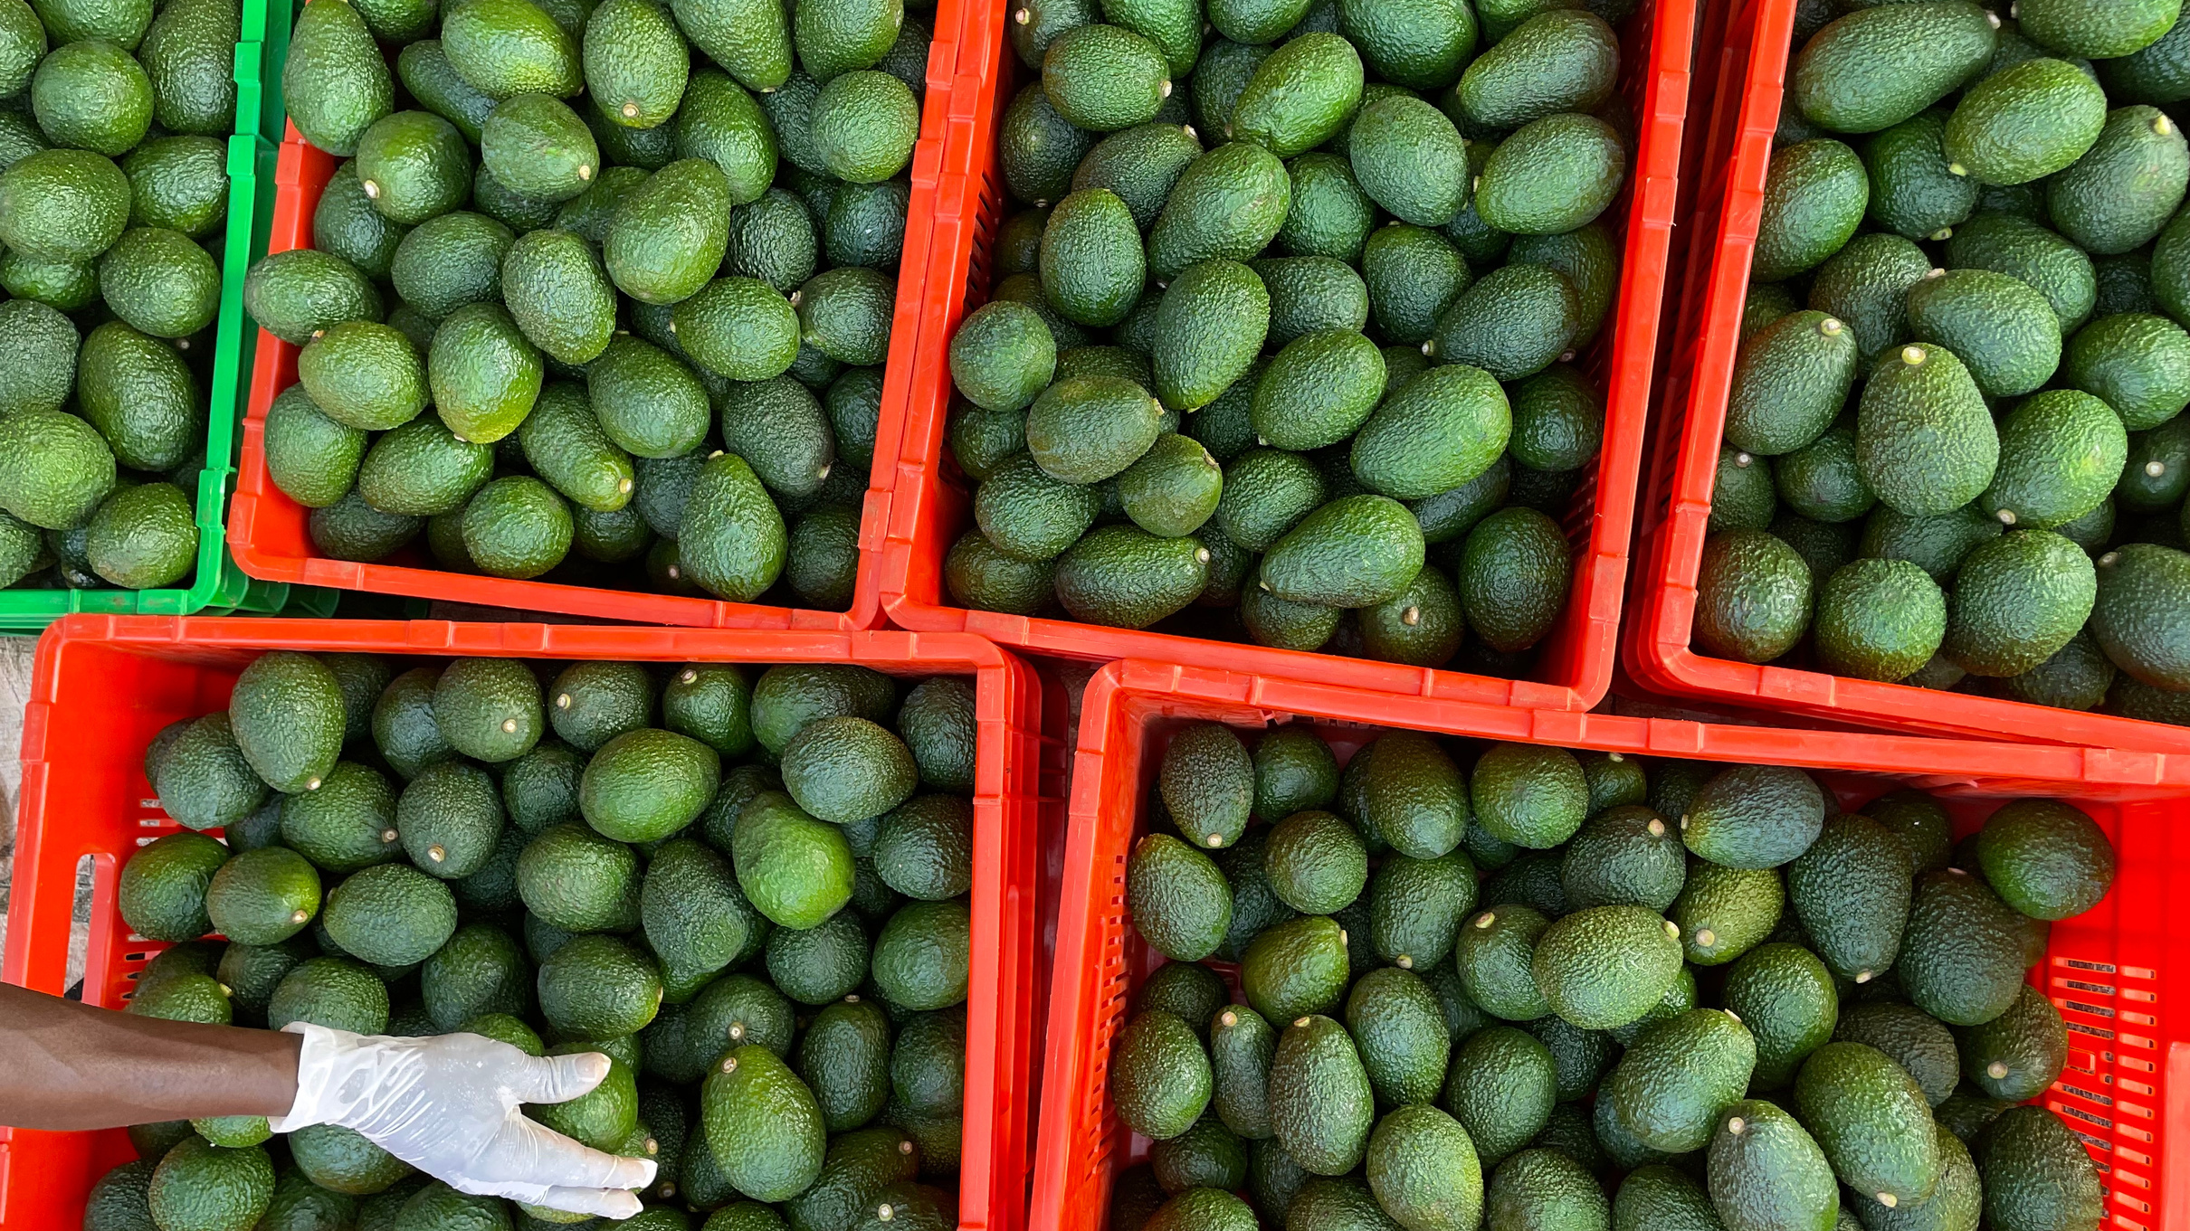
Building Relationships
Developed by Rachael Kirui

Slide 21
1.Start with Shared Values, Not Just Need
Strong funder relationships begin with alignment, not just financial asks. Before reaching out, take the time to understand a funder’s mission, priorities, and past grantees. Read their blogs, reports, or strategy papers.
Approach with a mindset of partnership — asking not just “Can you fund us?” but “How does our work help you achieve your vision?”

Slide 22
2.Treat Every Interaction as Relationship-Building
Every touchpoint with a funder — whether it’s an email, a social media interaction, or a brief chat at an event — is a chance to build connection. Be consistent and personable. Share updates even when you're not actively seeking funds.

Slide 23
Face-to-Face Fundraising
Prepare a story + number ahead of time.
Be a human first: ask what they enjoyed about the event.
Keep it short and memorable — 2-minute elevator intro + a leave-behind (postcard, short impact sheet, or even WhatsApp QR code).
Tools- hihello- e-business cards.

Slide 24
Sustaining the Relationship After Funding
Invite them to low-key events: farmer showcases, webinars.
Share short success stories regularly (image + quote + stat).
Ask them to weigh in, not just fund: “We’d love your advice on X.”
Share challenges too- with how you’re addressing them.
Funders value transparency more than perfection.

Slide 25
Activity
We’re going to do a 10 minute exercise followed by 10 minutes critiquing

Slide 26
Resources
Media Action Grassroots Network
Donorly Free Annual Fundraising Plan Template for Nonprofits
Grassroots Grantmakers: A Short Course on Grassroots Grantmaking

Slide 27
Thank You for Your Time
Developed by Rachael Kirui

